Slide 1
LT3354 Experience, analyse and evaluate representative online MT services
Group 11
Lam Yat Yeung 54024586
SHI Yibing 54018715
Wan Yuwei 54382027
Notes:
Good morning everyone, we are group 11
I’m Mia……I‘m Jack……I‘m ?
Today we are going to give a presentation about evaluating representative online MT services ’

Slide 2
Agenda
Introduction
Analysis
Lexical
Syntax
Extra Phenomena
3. Interface design
4. Conclusion
Notes:
Here is out agenda

Slide 3
Introduction
After 1980, we enter the third generation of machine translation—Knowledge-based MT
Statistical-based MT (SBMT)
Translation memory (TM) & example-based MT (EBMT)
Neural network MT (by Deep Learning)
Nowadays machines have better performance, but we find that machine translation still have different kinds of problems.
To test these problems, we choose five popular online machine translation services .
Notes:
According to what we have learnt, we are in the stage of Knowledge-based MT now. But there is still a long way to go. To test the problems, we choose five popular online machine translation services.

Slide 4

Google Translate
Statistical Machine Translation service launched in 2006.
Switched to Neural Machine Translation engine in 2016.
Baidu Translate
Launched in 2011.
EBMT, SMT, and rule-based translation incorporates into NMT..
Youdao Translate
SMT(2007)-->NMT(2017)
Web page extraction
Bing Translate
Launched by microsoft in 2009
Using Statistical Machine Translation service
Collins Translate
A function provided by Collins dictionary
Notes:
They are provided by Google, Baidu, Youdao, Bing and Collins. Google Baidu Youdao have turned to Neural Machine Translation in various degree.Bing and collins are still using Statistical Machine Translation

Slide 5
Aspects of MT evaluation (Hutchins & Somers, 1992)
•Text quality------Use different input to test
The quality of translation
•Extendibility The ability of adding new language pairs
•Operational capabilities Different kinds of function •Efficiency of use Time and portability
Central issue!
------Interface design
Notes:
We use four criterias to evaluate them. Text quality is the central issue. And we also have interface design analysis for extendibility, operational capabilities and efficiency of use.

Slide 6
1.
Lexical Analysis
Notes:
First let me talk about lexical analysis

Slide 7
1.Lexical words from Chinese dialects
Words originated from Chinese dialects but now become widespread and commonly accepted.These dialects should be categorized into fixed expressions.
Example 1: Input: 你真會忽悠人 Baidu：You know how to fool people ✓ Google：You will really 忽悠 people Youdao：You’re a fool. Bing: You’re a real jerk. Collins: You're a real jerk.
Example 2: Input: 她是我的發小 Baidu：She is my friend ✓ Google：She is my hair small Youdao: She's my hair Bing: She's my little hair. Collins: She's my little hair.
Example 3: Input:他平時沒有練習，現在出洋相了 Baidu: He usually did not practice, now spectacle.？ Google:He usually did not practice, now out of the ocean Youdao:He doesn't practice, he makes a fool of himself.✓ Bing: He's not practicing.（） Collins:He's not practicing.（）
Possible reasons:
Samples are not enough for machine to be trained.
Machine do not know the real meaning of these expressions and treat them as separated words.
Notes:
We test some words from Chinese dialects. For example, 你真会忽悠人, 忽悠 is northeast dialect. Only Baidu gives the right answer.Google remains unchanged. The other three have wrong meaning. Next is 发小, Beijing dialect, means good friend since childhood. Again,Baidu gives right answer, though it’s not very concise. Other translators use word-by-word translation. The last example is 出洋相. Its Shanghai dialect. This time Youdao gives right answer. Baidu gets the meaning but it has problem with syntax. Google translate it word-by word as out of the ocean.
These mistakes maybe caused by lack of training. So machine treat them as separated words.

Slide 8
2. Special classifiers in Chinese
They have unique express and convey special meaning
Example 1 Input: 一擔糧食 Baidu: A load of grain ✓ Google:A bear food Youdao:A bear grain ？ Bing: A grain of food Collins:A grain of food
Example 2
Input:我買了一提啤酒
(our version: I bought six bottles/tins of beer.)
Baidu: I bought a beer
Google:I bought a beer Youdao:I bought a beer Bing: I bought a beer Colins:I bought a beer
None is correct
Notes:
The second topic is special classifiers in Chinese. They have unique express and convey special meaning. For example, 一担粮食, only Baidu gives right answer. Other ones are word-by-word translation
Next example is 一提, which means six tin/bottles in one package.. But they all translate as I bought a beer

Slide 9
Example 3 Input: 三斤猪肉
(our version: one and a half kilo of pork) Baidu: Three kilos of pork Google:Three pounds of pork Youdao:3 kg of pork Bing: Three kg pork Colins:Three kg pork
Example 4 Input: 他買了一兩香菜
(our version: he bought fifty gram cilantro) Baidu: He bought one or two cilantro Google:He bought one or two coriander Youdao:He bought one or two cilantro Bing:He bought a couple of cilantro Colins:He bought one or two cilantro
No one is correct
again!
Possible Reasons:
1.English doesn’t have corresponding one with same meaning. 2.The records of certain word’s meaning are incomplete.
3.Mistakes in original pairs may also happen.
Notes:
Here we have two more examples, 斤and两
斤 in Chinese means a half kilo, but they translate as one kilo/pound. 两means fifty gram, but they translate 一两 as one or two.
We guess that the reasons are: English doesn’t have corresponding meaning, the records are incomplete or original mistakes happened in data.

Slide 10
3. Parts of body expressing frequency
i.As complement:
Input: 他打了我一耳光(一?)
Baidu: He slapped me in the face
Google: He slapped me
Youdao: He slapped me in the face
Bing: He slapped me in the face.
Collins: He slapped me in the face.
Input: 他看了我一眼(一?)
百度：He took a look at me
谷歌：He glanced at me
有道：He gave me a look
Bing: He glanced at me.
Colins: He glanced at me.
Input: 他踢了我一脚(一?)
Baidu: He kicked me
Google:He kicked me
Youdao: He kicked me in the foot
Bing: He kicked me in the leg.
Colins:He kicked me in the leg.
Input: 他打了我两耳光
Baidu: He hit me in the two slap ?
Google: He slapped me both ears
Youdao: He slapped me in the face( )
Bing: He slapped me twice. ✓
Collins: He slapped me twice. ✓
Input: 他看了我好几眼
百度：He looked at me in a few eyes
谷歌：He looked at me a few times ✓
有道：He looked at me several times ✓
Bing: He looked at me for a couple of eyes.
Colins: He looked at me for a couple of eyes.
Input: 他踢了我三脚
Baidu: He kicked me three ( )
Google:He kicked my ( ) legs
Youdao: He kicked me three feet
Bing: He kicked me three feet
Colins:He kicked me three feet
Notes:
The third topic is part of body expressing frequency.
When they are complement. For example, Youdao, Bing and Collins have problems in 一脚，they thought that my foot/leg is the part be kicked
when we increase the number, things become worse. Most of them have word-by-word translation or just leave it alone

Slide 11
ii.As a modifier：
Input: 他出了一头的汗
Baidu: He sweating out of his head ✓
Google: He had a sweat
Youdao: He was sweating like a man ?
Bing: He's sweating.
Collins: He's sweating.
Input: 他带着一脚的泥走进屋
Baidu: He walked into the house with muddy feet ✓
Google: He entered the house with a kick of mud
Youdao: He walked into the room with a foot of mud
Bing: He walked into the house with a foot of mud.
Collins: He walked into the house with a foot of mud.
Input: 他一脸的不高兴
Baidu: His face was unhappy ✓
Google:His face is not happy ✓
Youdao:He was unhappy with his face
Bing: He was unhappy with his face.
Collins:He was unhappy with his face.
Possible Reasons:
1.English does not use body part as measure word or modifier.
2.The samples are not enough for machine to be trained. Machine may translate them word by word.
Why baidu performs better:
It has more wide-ranging Chinese vocabulary in its corpus.
It uses example-based MT at the same time.
Notes:
When they are modifiermodifier. Baidu give right answer for them all, and Google gets the last one right. Other MT don’t treat it as a modifier or just leave it alone.The possible reason maybe English does not have such expressions.
After analysis, we can found that Baidu performs better in lexical part. The reason maybe its wide-ranging Chinese vocabulary and using example-based MT at same time.

Slide 12
2.
Syntactic Analysis

Slide 13
4. Complex NP with clausal modifiers
Example 1:
Input: 她說的話
Baidu: what she said✓
Google: she said something
Youdao: what she said✓
Bing: what she said✓
Collins: what she said✓
Example 2:
Input: 她提出來的想法
Baidu: The idea she put forward ✓
Google: She put forward the idea
Youdao:She came up with the idea
Bing: The idea she brought up ✓
Collins: The idea she brought up ✓
Example 3:
Input: 她發出來的聲音
Baidu: The sound she made ✓
Google: The sound she made ✓
Youdao: She made a sound
Bing: The sound of her voice ✓
Collins: The sound of her voice ✓
Google & Youdao acts badly
Problem: not preserving the NP structure
Possible Reasons:
Word order of subclause in Chinese
Notes:
Now I’m going to show some cases about syntactic structures to you. First let’s look at the complex NP with clausal modifiers in Chinese. For example, in the noun phrase “他說的話”, “他說的” is a subclause modifying the head noun “話”. We can see across the three examples, google and youdao’s performance are relatively bad, since they do not preserve the np structure of the input, but translate them into sentences. Possible reasons are that in the subclause of chinese, the head noun is always placed at the final position, whose word order of is very similar to a normal statement sentence, with an addition of “de”. In this case, the translators may confuse the two structures and translate it into a sentence.

Slide 14
4. Complex NP with clausal modifiers--more complex!
Example 1:
Input: 她提出來的賣掉房子的想法
Baidu: She put forward the idea of selling the house
Google: She put forward the idea of selling a house
Youdao: She brought up the idea of selling the house
Bing: She raised the idea of selling the house.
Collins: She raised the idea of selling the house.
Reference: the idea of selling the house put forward
by her
Example 2:
Input:她說的侮辱老師的話
Baidu: She insulted the teacher’s words
Google: She said insulting teacher’s words
Youdao: What she said was insulting to the teacher ?
Bing: She said insult to the teacher
Collins: She said insult to the teacher
Reference: the insulting words to the teacher said by her
Faithfulness!
None acts well!
Possible reasons:
Lack of syntactic knowledge: constituent grouping and the hierarchical structure [the modifiers should be attached to the last head noun, and separated by “的”]
Notes:
However, When we insert one more clausal modifier to the np, we can see none of the translators can perform well, as all of them translate the np to a sentence. Although the meaning is still understandable, they lose the information of the structure, which is a matter of faithfulness. Also, the possible reasons maybe that in the complex structure, it is more difficult for machines to do the constituent grouping and the hierarchical structure analysis. As we can see, the first modifier should be attached to the last head noun, and between them there is a long way

Slide 15
5. Resultatives
Verb-Verb/Adjective Compound: with the second verb indicating the result of the first verb
When the result is predicted on the object
Example 1:
Input: 他打碎了杯子
Baidu:He broke the cup ✓
Google: He smashed the cup ✓
Youdao: He broke the cup ✓
Bing: He broke the cup. ✓
Collins: He broke the cup. ✓
Example 2:
Input: 我趕跑了他
Baidu: I chased him
Google: I drove him
Youdao: I drove him away ✓
Bing: I chased him away. ?
Collins: I ran him.
Example 3:
Input: 張三踢壞了我的桌子
Baidu：Chang three kicked off my desk ?
Google：Zhang San kicked my desk broken ✓
Youdao：Zhang SAN kicked my desk
Bing: Zhang kicked my desk.
Collins: Zhang kicked my desk.
Problem: no translation for the “result”
Possible reasons:
Example 1: words in English by nature contain the meanings of the result
Example 2 & 3, no such corresponding words in English
Notes:
Another case is concerned about the resultatives in chinese, which refer to some special verb-verb/adjective compound in chinese, when the second word indicats the result of the first action verb, like...and for these three cases, the results are predicted on the object. As for the results, we can see for example 1, all of the translators perform well, the reasons may be that there are words like “break” in English, which already contain the meaning of an action and the result, it is very similar to chinese. But for example 2 and 3, most of them do not translate the word for “result”. Reasons are that there are no such corresponding words in english, and thus it is more difficult for the machines to process.

Slide 16
5. Resultatives
Verb-Verb/Adjective Compound: with the second verb indicating the result of the first verb
When the result is predicted on the subject
Example 1:
Input: 他吃飽了飯
Baidu: He was full of food
Google: He is full of food
Youdao: He was full ?
Bing: He's full of food.
Collins:He's full of food.
Reference: He ate food and became full.
Example 2:
Input: 他打累了羽毛球
Baidu: He was tired of playing badminton
Google:He is tired of badminton
Youdao:He is tired of playing badminton
Bing:He is tired of playing badminton
Collins:He is tired of playing badminton
Reference: He played badminton and became tired
Problem:
No translation for the action verb
Translate the “result” as a current state rather than as a change of the state
Incorrect semantic translation for the “result”
Possible reasons:
Inadequate knowledge acquisition of the semantic meanings of the resultative
Notes:
However, in chinese there are also resultatives when the result can be predicted on the subject, like “他吃飽了飯” it is “他飽了”rather than“飯飽了”. As for the results, for “她吃飽了飯”, all the translators do not translate the action verb; and in both cases, they translate the “result” as a current state, which is not true since the resultative indicates a change of the state from not full to full after the action eating; also the translation is still incorrect in meanings, since “be full of” means 充滿, and be tired of means 厭倦. The reasons may be that the machines do not FULLY understand the semantic meanings of the resultative.

Slide 17
5. Resultatives
Verb-Verb/Adjective Compound: with the second verb indicating the result of the first verb
When the situation is more tricky! The result can be predicted on either subject/object
Example 1:
Input:他騎累了馬
Baidu:He was tired of riding horses → the adjective modifies the subject
Google: He rode tired horse
Youdao:He tired the horse
Bing: He rode a tired horse → the adjective modifies the object
Collins: He rode a tired horse → the adjective modifies the object
Reference: He rode the horse and became tired/
He rode the horse and the horse became tired
Problem:
Inability to discover the ambiguity implied by the construction
Notes:
Also there are some interesting cases when the result can be either predicted on the subject or the object, like the sentence. In such cases, the translators act very differently

Slide 18
6. A-not-A sentences in Chinese
The incomplete form of A-not-A
Example 1
Input: 你理不理解這件事？
Baidu: Don't you understand it?
Google: You do not understand this matter?
Youdao: You don't understand this?
Bing: Do you understand this matter? ✓
Collins: Do you understand this matter? ✓
Reference: Do you understand this matter or not?
Example 2
Input: 你希不希望他來？
Baidu: Do you want him to come? ✓
Google: Would you like him to come? ✓
Youdao: You don't want him to come?
Bing: Do you want him to come? ✓
Collins: Do you want him to come? ✓
Reference: Do you want him to come or not?
Problem: translate into a marked interrogative (‘don’t’)
Possible reasons:
The machine translators are disturbed by the negation “不”
The machines don’t know how to process the single word
Notes:
The next case is about a-not-a sentences in chinese. First let’s consider the incomplete forms of A-not-A. It means that the first word before the negation is not complete, like in “理不理解” here actually “解” in the first word is omitted. We can see in the translations, many translators use the “don’t” form, which is not the actual meaning of the original sentence. Possible reasons are that the machines are disturbed by the negation, or maybe they don’t know how to process the single word “li” and “jie”

Slide 19
6. A-not-A sentence in Chinese
The complete forms of A-not-A
Example 1
Input: 你理解不理解這件事？
Baidu: Do you understand that you don't understand it?
Google: You understand do not understand this thing?
Youdao: Do you understand this matter? ✓
Bing: Do you understand this matter? ✓
Collins: Do you understand this matter? ✓
Reference: Do you understand this matter or not?
Example 2
Input: 你希望不希望他來？
Baidu: Do you wish you wouldn't want him to come?
Google: You do not want him to come?
Youdao: Would you like him to come? ✓
Bing: You want him to come? ✓
Collins: You want him to come? ✓
Reference: Do you want him to come or not?
Baidu & Google perform worse!
Possible reasons:
A matter of segmentation;
word-by-word translation
Youdao performs better
Better to process full form
Notes:
However, when we use the same sentence with only changing the incomplete form to complete one, we can see the results are very different. Baidu & Google performs worse, cuz in the previous case, though they use the incorrect sentence structure, the meaning is still preserved. But here the translation is just in a mess. This result may be due to the incorrect segmentation, as the machines place the boundary after “lijie” and then processes the following segment as a clause of the main verb “lijie”. In contrast, we can see youdao performs better for the full form.

Slide 20
7. Syntax: Tense/Time
Input: 他結了婚
Baidu: He was married
Google: He is married
Youdao: He is married
Bing: He was married
Collins: He's married
Input: 他結過婚
Baidu: He was married
Google: He is married
Youdao: He married
Bing: He was married
Collins: He's married
“他結了婚” implies that he married someone and now is still at the state of being married.
“他結過婚” implies that he got married before, but now is probably not at the state of being married anymore.
Possible reasons :
The sentence with implicature is hard to be translated.
Lack of syntactical rules for Chinese particle
Real-world knowledge is needed.
Notes:
Now i will talk about the issue related to tense.
Basically, the translators we have tried can deal with the past tense indicator “了" and "過" quite accurately. But we found a special case.
When we say 他結了婚. It implies that he has got married and now is still at the state of being married. So the right saying should not be He was married. So we can see that Baidu and Collins cannot score any marks in this case. Surprisingly, google, youdao and collins can translate it correctly.
Then for the saying "他結過婚". It implies that he got married before, but now is probably not at the state of being married anymore.. In this case, Baidu and Bing is correct. But Google, Youdao and Collins are all fail.
However, it is noticeable that the translation of these two sentences are exactly the same, except Youdao. So it is assumed that that all regard 了 and 過 are the same in this context.
this example tells that the sentence with implicature is hard to be translated. It requires not only enough syntactical rules but also real world knowledge.

Slide 21
3.
Extra Phenomena
Notes:
Next, i will talk about some extra findings

Slide 22
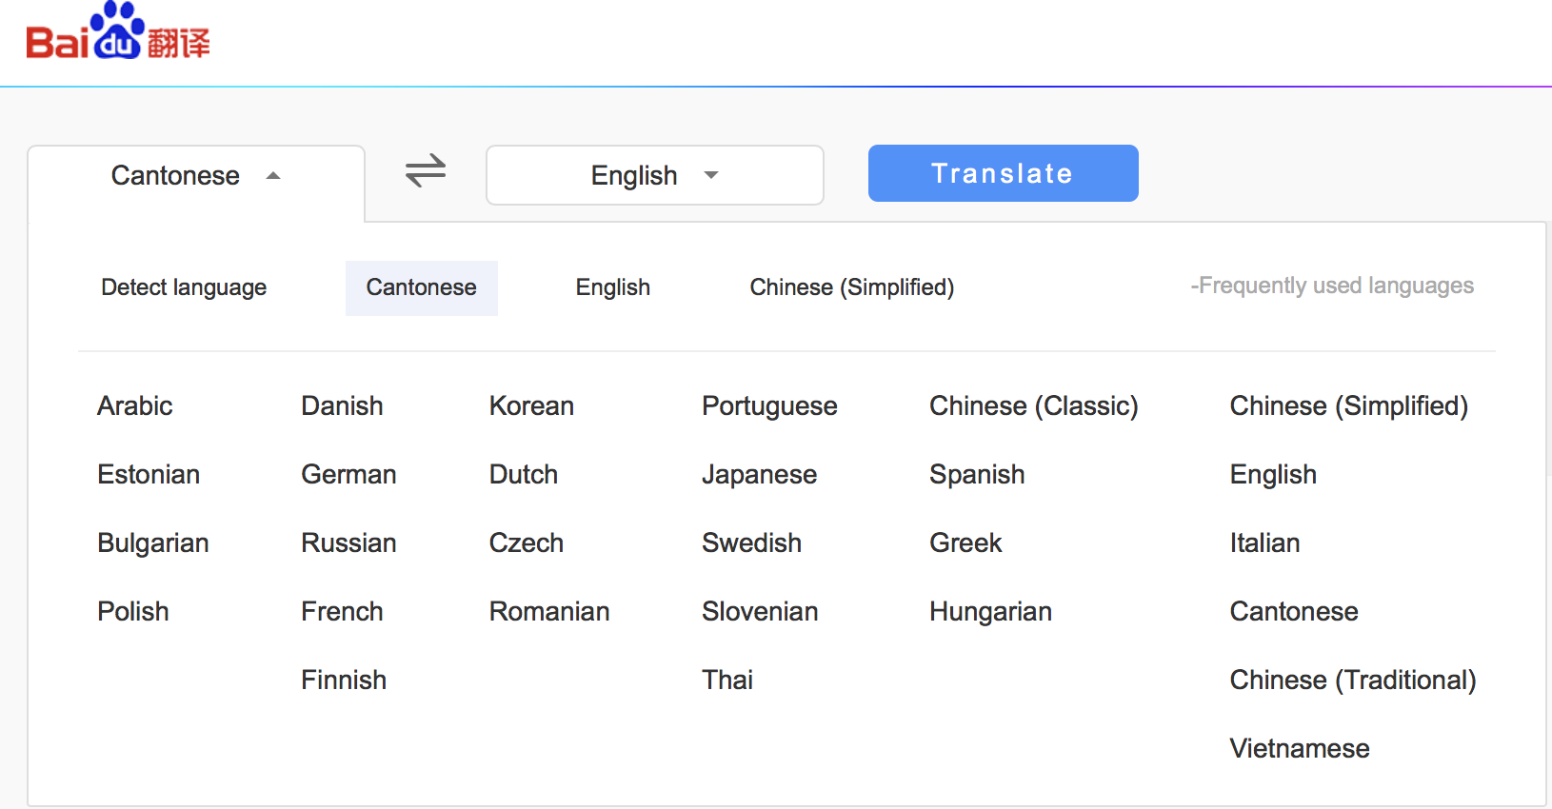
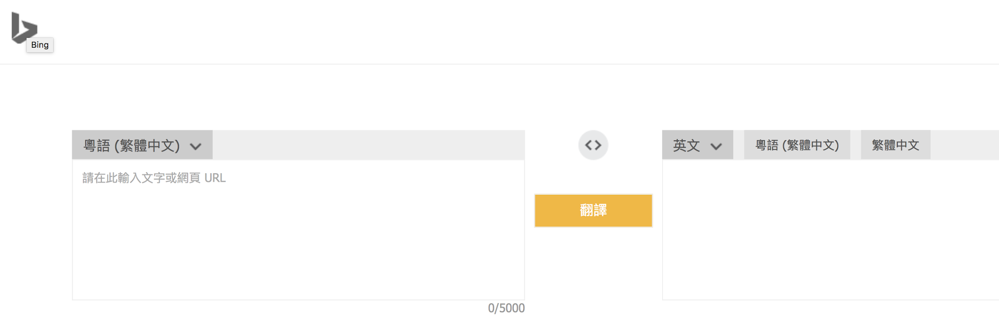
Cantonese translator
Notes:
We found that Baidu and Bing provide Cantonese translation. But it is obviously less reliable comparing with Chinese-English translation.

Slide 23
Cantonese translator
Input: 佢好靚女
Baidu: He is a pretty girl.
Bing: She’s beautiful
他 ＝He 佢 ＝He / She (Ambiguous)
她 ＝She
Possible reasons:
Word-for-word translation
Lack of real world knowledge
Notes:
And we found that Baidu cannot accurately deal with the third-person pronoun in Cantonese, 佢 which is ambiguous in terms of gender-specification. But in some context like 佢好靚女, 佢 must be she. But Baidu mistranslates it as He’s a pretty girl, while Bing can correctly translate it.
The mistranslation maybe due to word-for-word translation and the lack of real world knowledge.

Slide 24
Paragraph translation
Input: 美国肯塔基大学通过植入能杀灭多种癌细胞且不会伤害正常细胞的“Par-4”肿瘤抑制基因，成功培育出能抗癌的实验鼠，对人类抗癌研究具有重要借鉴意义。如果能通过骨髓移植让“Par-4”作用于人体抗癌，就可以使癌症患者免除化疗放疗的侵害。
Baidu: University of Kentucky has successfully implanted an Par-4 tumor suppressor gene that can destroy many kinds of cancer cells and does not injure normal cells, and has successfully established an experimental mouse capable of anti-cancer. It has important reference significance for human anticancer research. If "Par-4" can be used in human cancer by bone marrow transplantation, cancer patients can be exempted from chemotherapy and radiotherapy.
Google: The United States University of Kentucky successfully implanted anti-cancer mice by implantation of "PAR-4" tumor suppressor gene that can kill many kinds of cancer cells without damaging the normal cells, which is of great significance to human anticancer research. If the "PAR-4" can be applied to the human body through bone marrow transplantation to fight cancer, cancer patients can be prevented from being infringed by chemotherapy and radiotherapy.✓
Youdao: The university of Kentucky by implanting can kill several kinds of cancer cells and not harm normal cells "PAR - 4" tumor suppressor genes, successfully developed cancer mice, has important significance in the study of human cancer. If a bone marrow transplant allows par-4 to protect against cancer, cancer patients will be exempt from chemotherapy and radiation.

Slide 25
Bing: The University of Kentucky has been able to successfully develop anticancer experimental mice by implanting a "Par-4" tumor suppressor gene that kills multiple cancer cells without harming normal cells, and is of great significance for human cancer research. If a bone marrow transplant allows "Par-4" to be used for human cancer, cancer patients can be exempted from chemotherapy and radiotherapy.
Collins:The University of Kentucky has been able to successfully develop anticancer experimental mice by implanting a ( )
Input: Using observations from the Very Large Telescope in Chile, Karen Meech, from the Institute for Astronomy in Honolulu, Hawaii, and colleagues determined that the object was at least 400m long, rapidly rotating and subject to dramatic changes in brightness.
Baidu: 通过观察来自智利，非常大的望远镜凯伦米奇，从在火奴鲁鲁，夏威夷天文研究所，和他的同事们确定对象至少400米长，快速旋转和受亮度变化。
Google: 利用智利超大型望远镜的观测资料，夏威夷檀香山天文学研究所的Karen Meech及其同事确定，该物体至少有400米长，快速旋转，亮度发生剧烈变化。✓

Slide 26
Youdao:来自夏威夷火奴鲁鲁市天文研究所的Karen Meech和他的同事们利用来自智利大望远镜的观察结果，发现这个物体至少有4米长，可以快速旋转，而且亮度会发生剧烈变化。
Bing: 使用来自智利的大型望远镜的观测, 来自夏威夷檀香山的天文学研究所的凯伦. 其和同事们确定, 该物体至少有400m 长, 迅速旋转, 并受到亮度的剧烈变化。
Collins: 使用来自智利的大型望远镜的观测, 来自夏威夷檀香山的天文学研究所的凯伦. 其和同事们确定, 该物体至少有400m 长, 迅速旋转, 并受到亮度的剧烈变化
Result:
Though Google did not do so well in above tests, it show us its extraordinary ability in paragraph translation.
Possible reason:
Google has large-scale data storage and more efficient calculation, which are very crucial in SMT

Slide 27
2.
Interface Design
Notes:
Now i will talk about the interface design of these 5 online translators

Slide 28
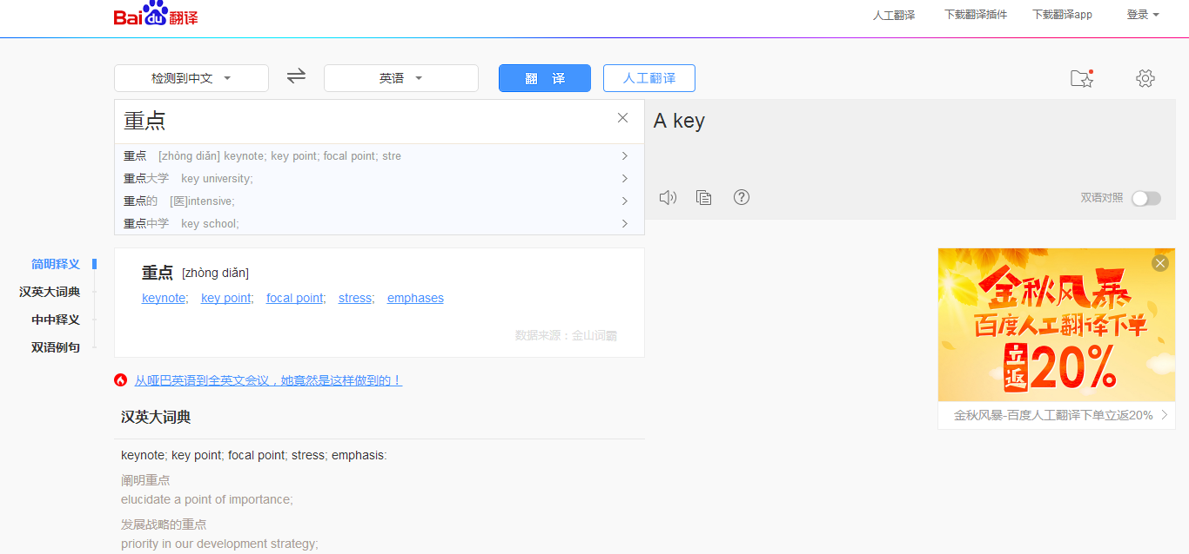
Baidu
immediate translation
Favourites
Word suggestion
& Input detection
Click to explore other replaceable options
& select to translate
Allow user to report error and improve
Key words dictionary
& example sentence
Bilingual comparison
•Extendibility: report error and allow for improvement ✓
•Operational capability: 28L+many functions+unique functions+relative clear interface ✓
•Efficiency: proper position; app; time(100 words-1.5s (a bit slow but ok)) ✓
Notes:
Let’s begin with Baidu.
For the input part, a list of word suggestion will pop out when we start typing. The user can click on the result to see other possible translation. It allows user to report any error and improve it. The unique function is the favourites and bilingual comparison function.

Slide 29
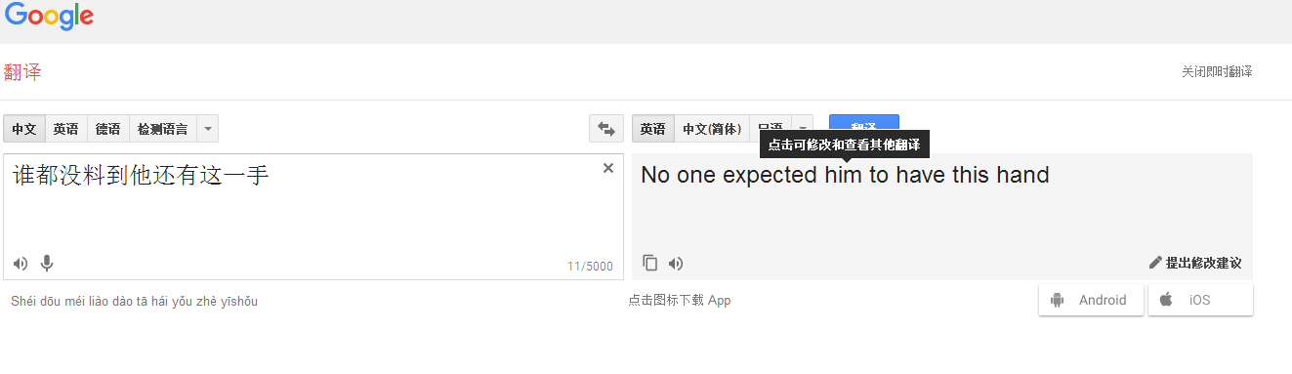
Google
immediate translation
Word suggestion
& Input detection
Speech input
& Pinyin notation
Words count
Clicking--Offer other replaceable options
Allow user to report error and improve
•Extendibility: report error and improve ✓
•Operational capability: 108L+many functions+unique functions+very clear interface ✓
•Efficiency: relative proper position; app; time(100 words-0.5s(very fast)) ✓
Notes:
Next for the google, it has all the function that baidu has, additionally it supports speech input and pinyin notation

Slide 30
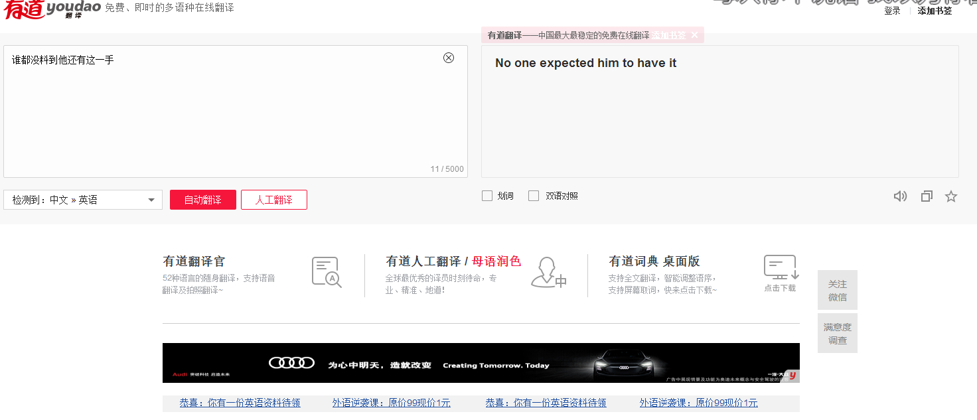
Youdao
immediate translation
Input detection
No word suggestion
select to translate
Give marks but no way to improve
•Extendibility: Give marks but no way to improve
•Operational capability: 8L + many functions + relative clear interface ✓
•Efficiency: relative proper position; app; time(100 words-0.6s(very fast)) ✓
Notes:
Next, for the Youdao. It’s relatively simple with less feature functions. There is no word suggestion for the input. It also supports immediate translation and click to see alternitive. And there is no way to repot and improve error. Users can only give marks.

Slide 31
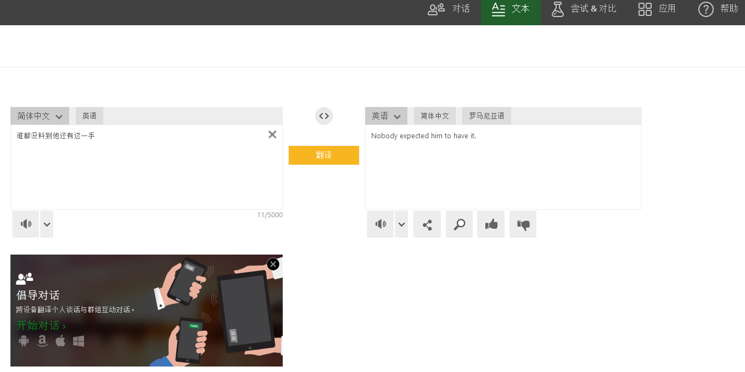
Bing
immediate translation
Share
& look up
•Extendibility: Give good/bad but no way to improve
•Operational capability: 37L+basic functions + unique functions + clear interface ✓
•Efficiency: relative proper position; app; time(100 words-0.6s(very fast)) ✓
Notes:
Next for the Bing, it’s very simple and plain. No word suggestion or click to see the alternitive. And there is no way to report and improve the error.

Slide 32
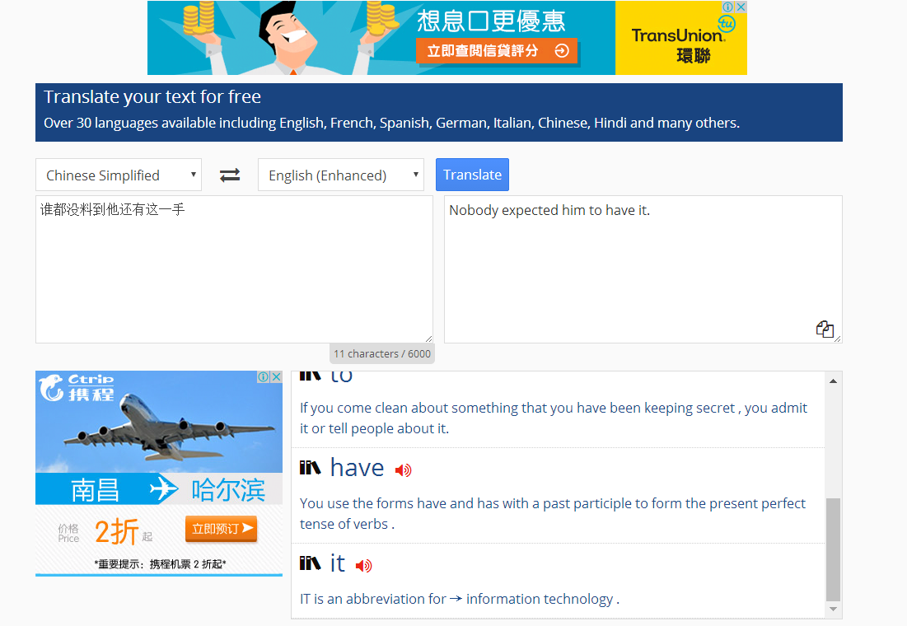
Collins
No immediate translation
Key words dictionary
•Extendibility: no marks/report error and no way to improve
•Operational capability: 30L + basic functions + unclear interface
•Efficiency: relative proper position; app; time(100 words-0.6s(very fast)) ✓
Notes:
Lastly, Collins. This is the most simple basic one. No any extended function but the dictionary. And it doesnt support immediate translation. User have to click the translate button whenever they enter a new input.

Slide 33
Conclusion
Notes:
Finally, let me give you a brief summary of our findings \

Slide 34
Text quality
Overall Performance:
Baidu & Youdao process Chinese language structures better.
Google performs better on translation of paragraph .
Common Problems:
Not large enough lexicon corpus
Still inadequate knowledge acquisition of Chinese linguistic structure
Miss information: not conform to the principle of Faithfulness
Interface Design
Baidu & Google do well according to all criteria,except for some tiny flaws.
Youdao & Bing lose some useful function.
Collins only have basic function with a unclear appearance.
MT can handle
sentences which have simple structure and context-free meaning.✓
But not complex structure and difference of language habits.
---->Still a tool. How to combine data driven models with prior knowledge is critical.
Notes:
For the text quality, generally speaking, baidu and youdao do better on chinese structure. And google performs better on translation of paragraph.
And there are several common problems among them. First, the lexicon corpus is not large enough. Second, the knowledge acquisition of chinese linguistic structure is still inadequate. Last but not least, they cannot conform to the principle of faithfulness
For the interface design, baidu and google have most extend functions and more user-friendly
After all, machine translation can handle sentences with simple structure and context-free meaning, but not complex structure.

Slide 35
Thanks!
Any questions?

